Slide 1
EMOTION RECOGNITION FROM FACIAL EXPRESSIONS
Kirthana Lakshmana Perumal (klakshma)
Neelima Srilakshmi Bollempalli(neelimas)
Nikhil Kumar Vadigala (nvadigal)

Slide 2
Abstract
Our project aims to develop and implement the advanced versions of Convolutional Neural Network (CNN) model with a capability to address the problem of vanishing gradients and precisely identify human facial expressions. We have evaluated model performance and integrated it with a live webcam feed to enable real-time application. The goal is to optimize the model for higher accuracy, ultimately intending to deploy it in real-world scenarios such as health monitoring systems or team communication platforms for more effective interactions.

Slide 3
Dataset
FER 2013 which has 7 classes ['Anger', 'Disgust', 'Fear', 'Happy', 'Neutral', 'Sadness', 'Surprise’] The training set consists of 28,709 images and the test set consists of 3,589 images.
Models Implemented
ResNet18
ResNet50
EfficientNet B0
EfficientNet B3
EfficientNet B5
MobileNet V2

Slide 4
Project pipeline
ResNet18
ResNet50
Model training
Output Results
Input
Data preprocessing
EfficientNet
MobileNet V2

Slide 5
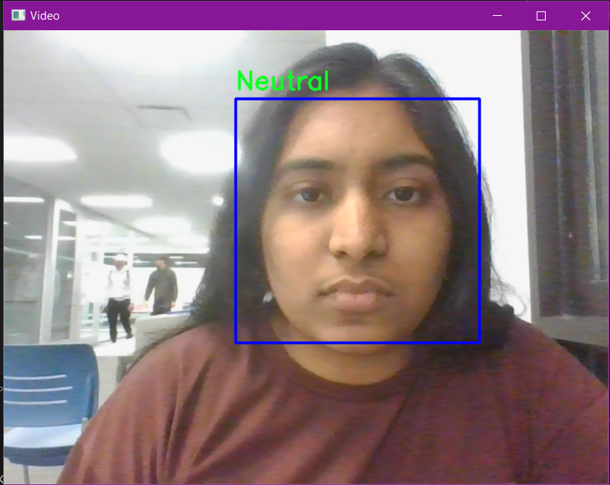
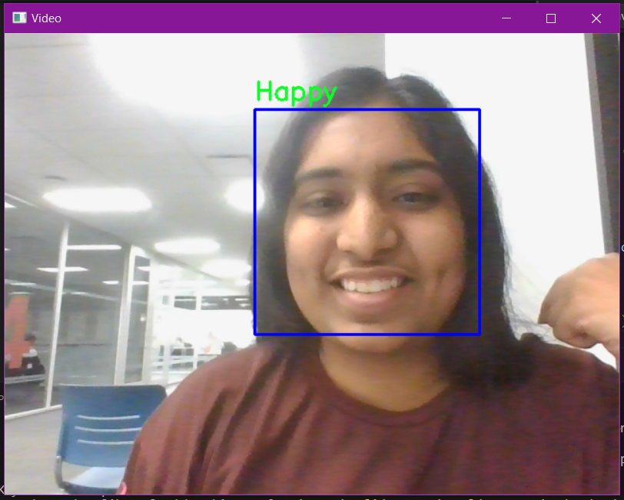
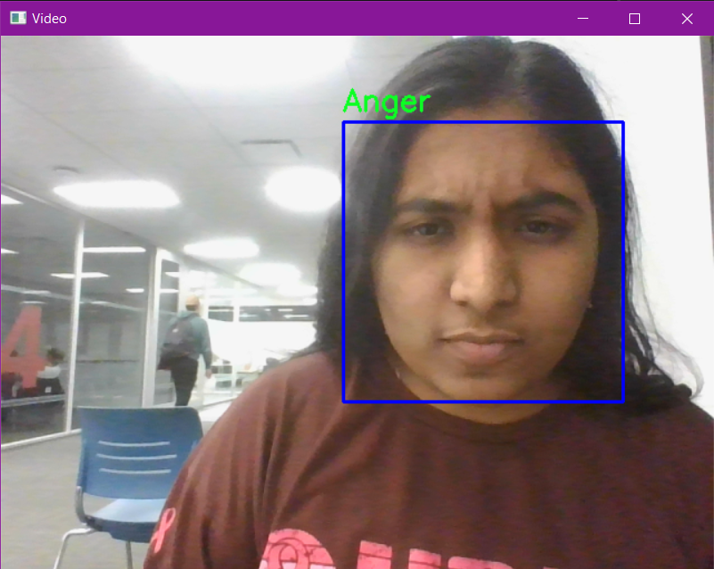
Output results

Slide 6
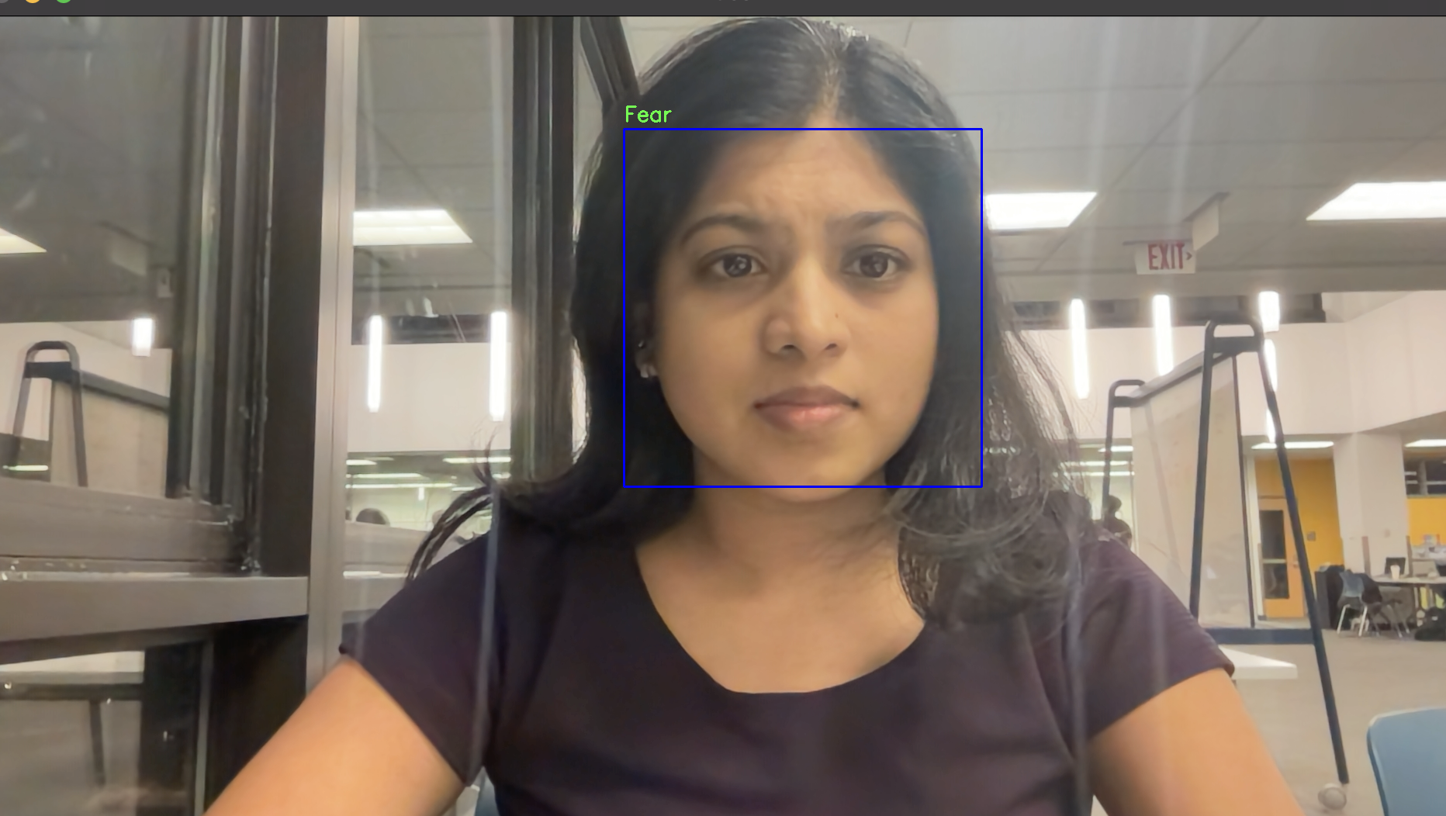
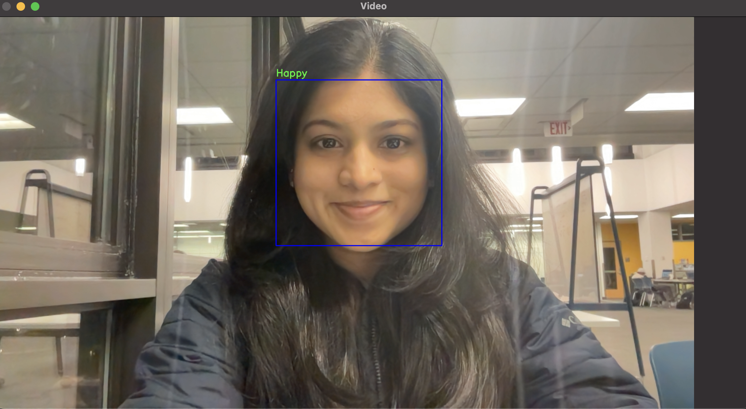
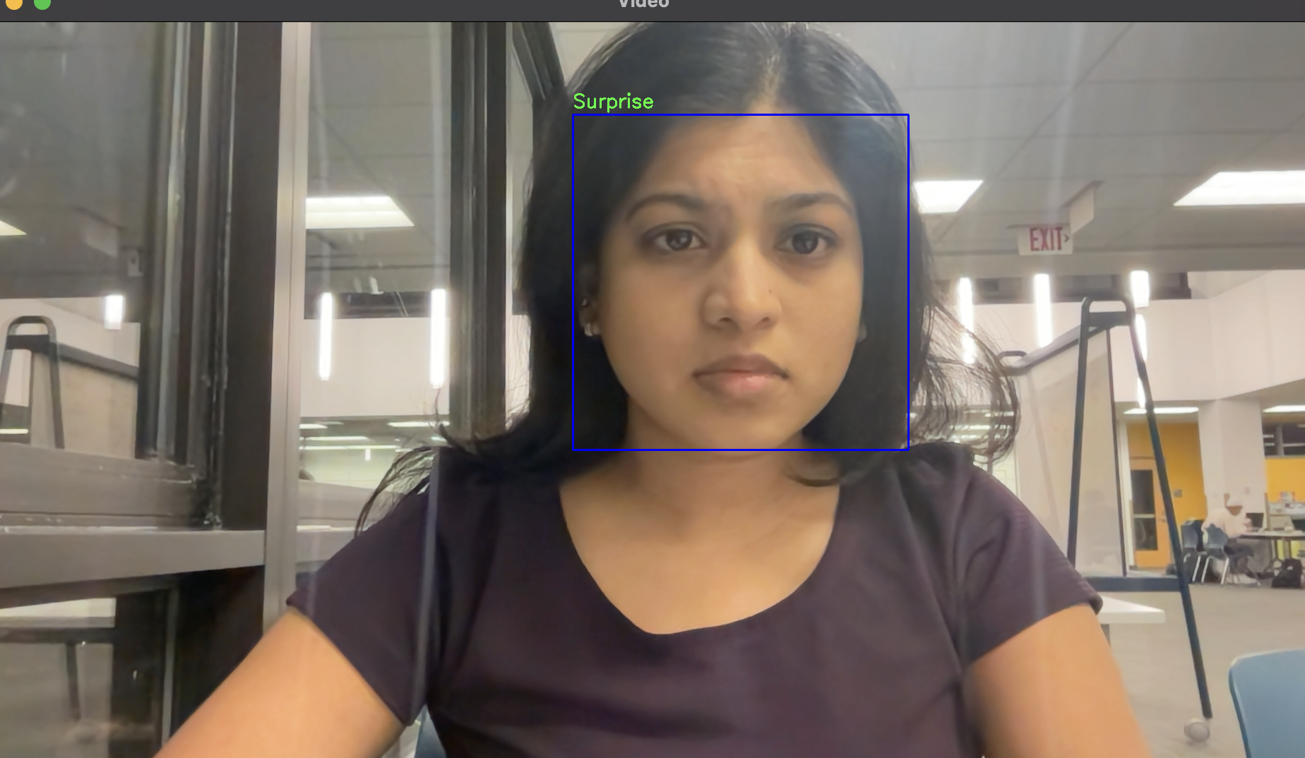
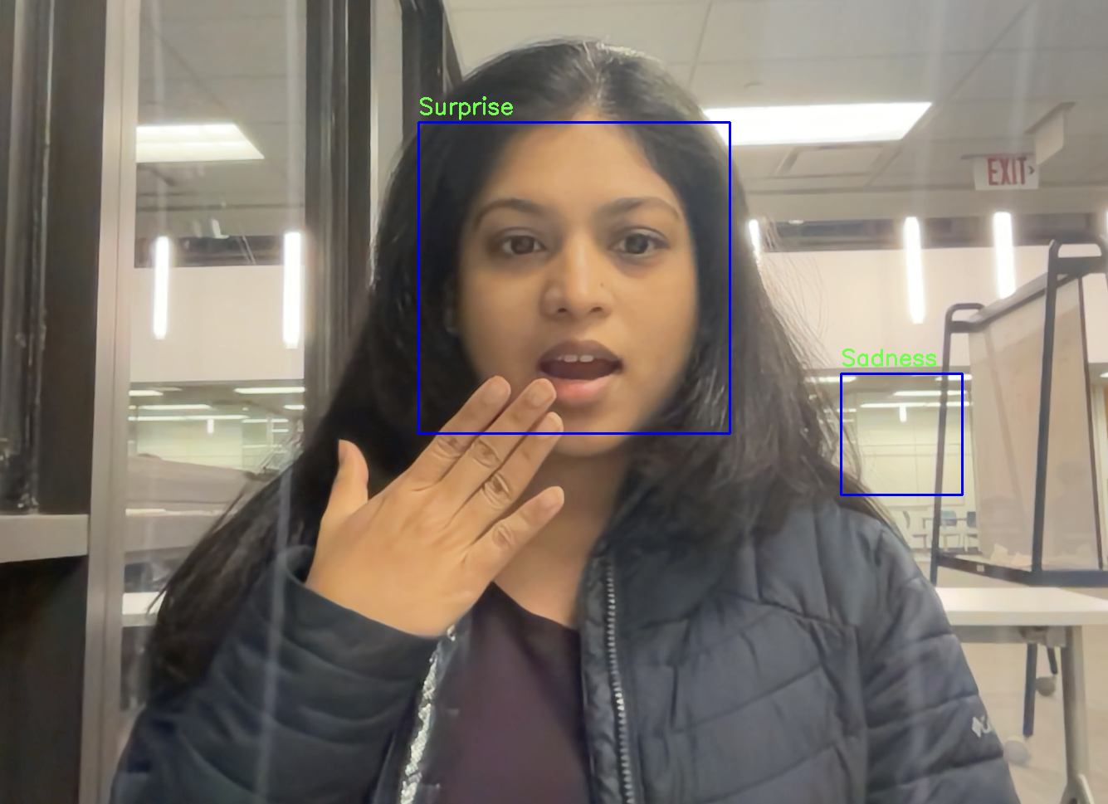
Output results

Slide 7
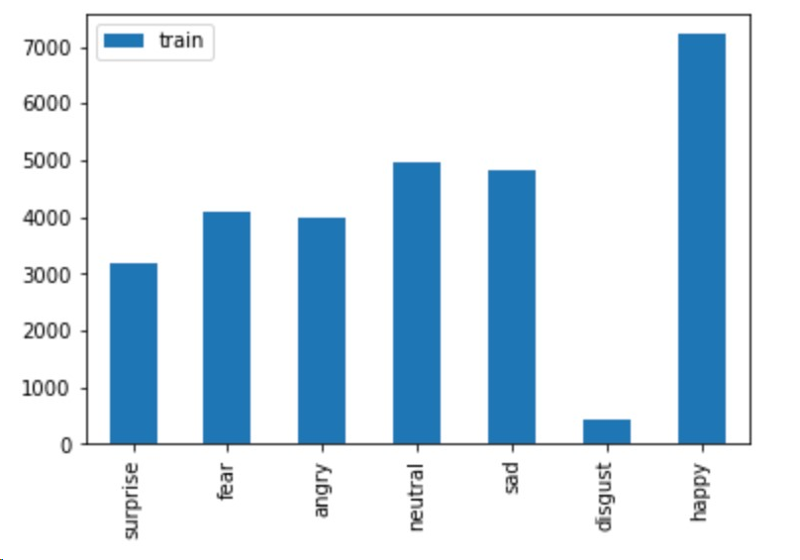
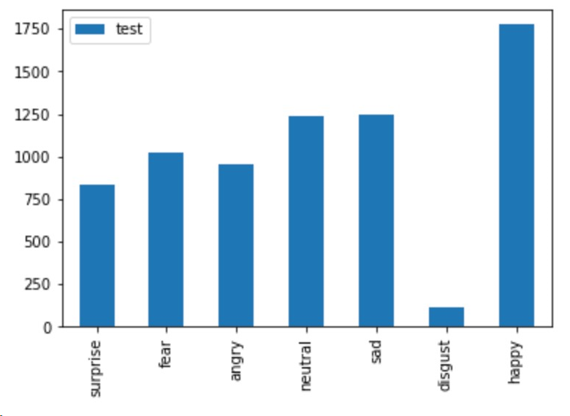
Data imbalance and pre-processing
Data imbalance is a major issue with the the FER2013 dataset, and it reflects in the emotion detection in the real-time camera.
We experimented our data with different pre-processing techniques such as resize and normalize, When we applied all the transformations such as rotation, vertical flip and horizontal flip, ColorJitter, we got a lesser train_accuracy.
Although, the data pre-proccessing is meant to improve the quality of images and boost them for further processing, sometimes it may lead to overfitting of augmented images.

Slide 8
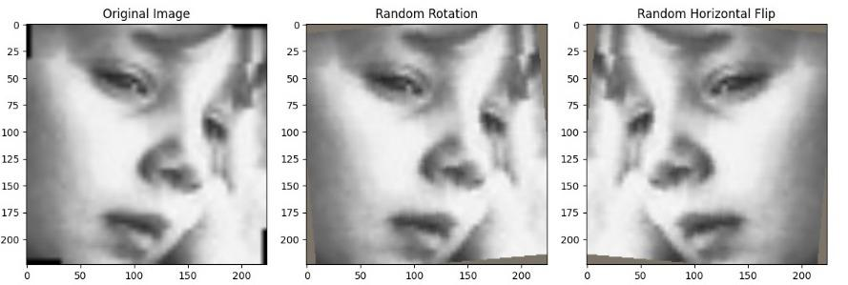
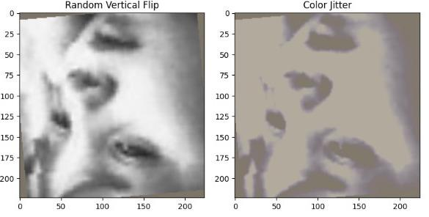
Data Pre-processing

Slide 9
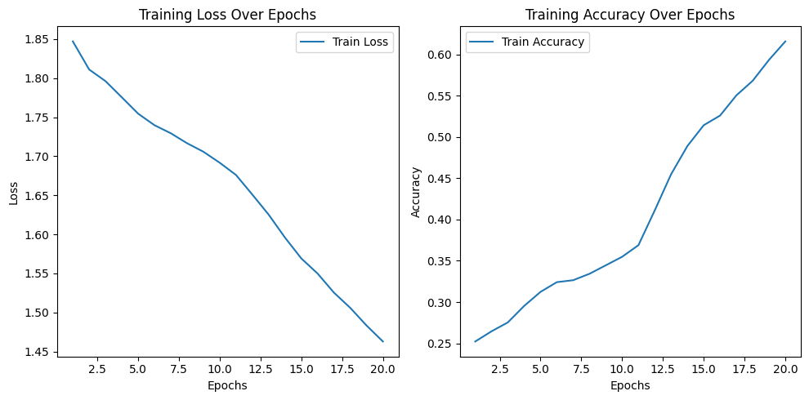
Experiment 1: Train ResNet18 on FER2013
We trained the model with LR = 0.01, BATCH_SIZE = 128, CrossEntropyLoss, and SGD optimizer
In the training process of our model.
After training for 20 epochs, the average training metrics were as follows, accuracy around 60% and loss around 1.46

Slide 10
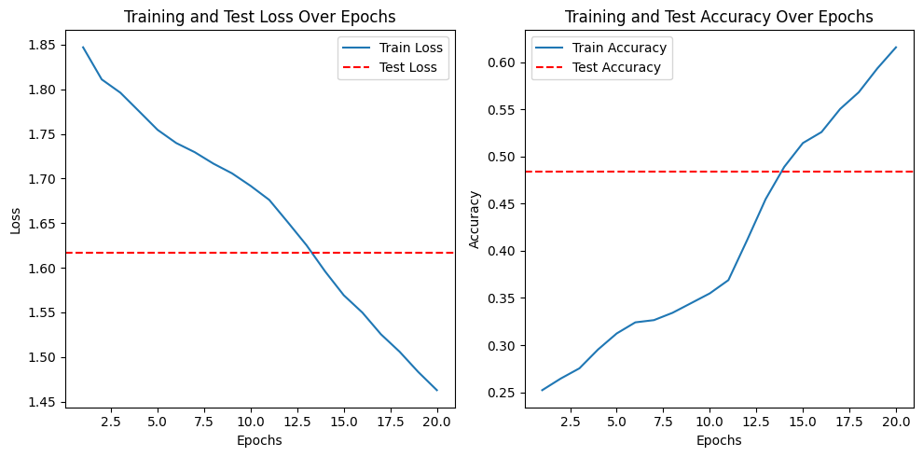
Experiment 1: Train ResNet18 on FER2013
While evaluating our model using our test_dataset, we got Loss: 1.6164, Accuracy: 0.4840

Slide 11
Experiment 2: Train ResNet18 with transformations
When we performed the Data preprocessing steps such as
transforms.RandomRotation(5),
transforms.RandomHorizontalFlip(),
transforms.RandomVerticalFlip(),
transforms.ColorJitter(brightness=0.2, contrast=0.2, saturation=0.2, hue=0.1)
We noticed a drop in the train_accuracy level, but increase in Test_accuracy
Train_loss: 1.416547835138109, Train_accuracy: 0.688
Test_Loss: 1.5279, Test_Accuracy: 0.5784

Slide 12
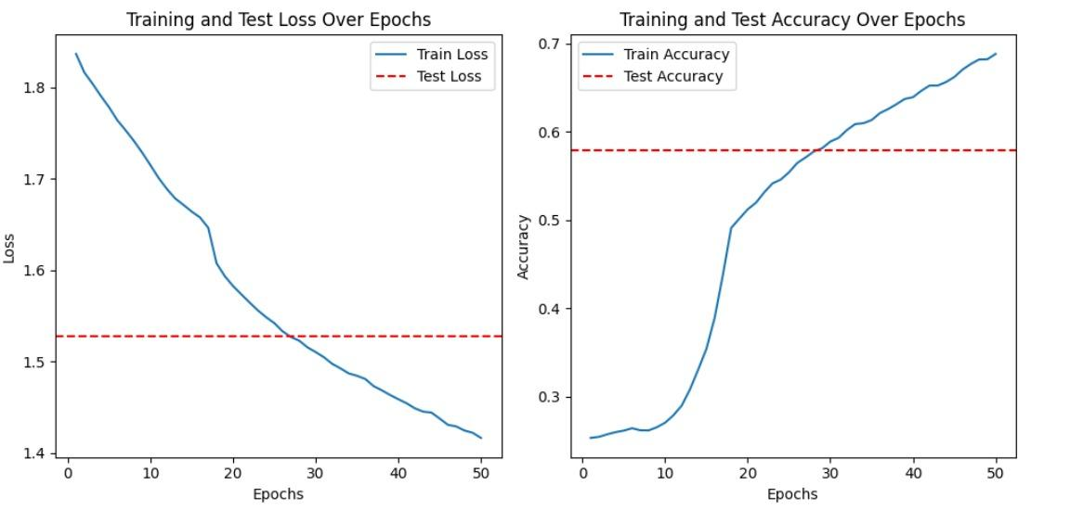
Experiment 2: Train ResNet18 with transformations

Slide 13
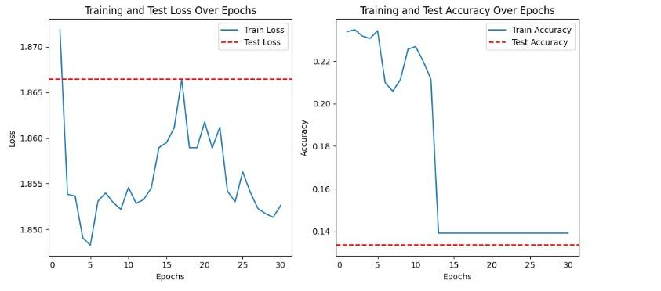
Experiment 2: Train ResNet18 with Adam optimizer

Slide 14
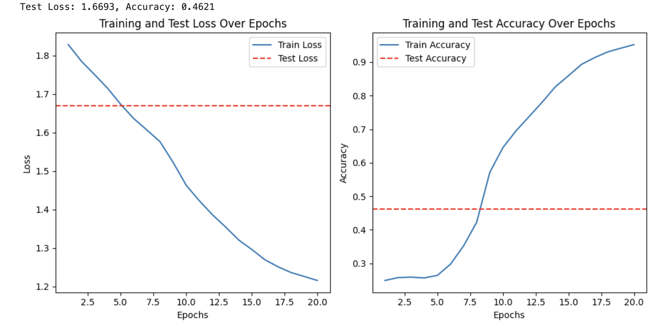
Experiment 3: Train ResNet50 on FER2013
We trained the model with LR = 0.01, BATCH_SIZE = 32 and CrossEntropyLoss.
After training for 20 epochs, the average training metrics were as follows, loss: 1.215853926870558, accuracy: 0.952
test_loss: 1.67, test_accuracy: 0.45

Slide 15
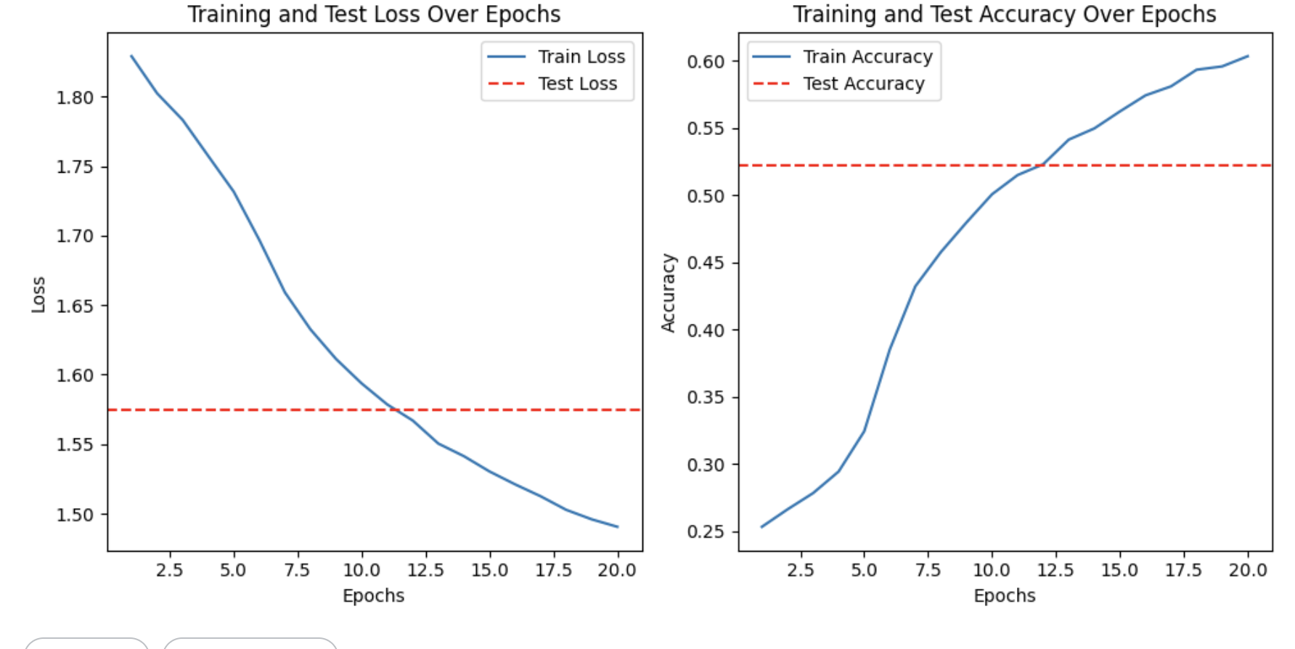
Experiment 4: Train ResNet50 on FER2013
When we applied all the transformation, we got train_loss as 1.49 and train_accuracy: 0.603
Test Loss: 1.5743, Test_Accuracy: 0.5220

Slide 16
Experiment 4: ResNet50 on FER2013 with Adam
When we applied all the transformation, we got train_loss as 1.49 and train_accuracy: 0.603
Test Loss: 1.5743, Test_Accuracy: 0.5220

Slide 17
EfficientNet
Instead of manually scaling our models like the ResNet, We chose EfficientNet to simultaneously scale the the width, depth and resolution .
It’s a State-of-the-art model which provides a better performance in terms of accuracy, lesser time for training due to their lightweight architecture with Mobile Inverted Bottleneck layers and Squeeze-and-Excitation for optimization.
We have used SiLU() activation function
Swish(x) = x * sigmoid(x)

Slide 18
EfficientNet
"b0" : (1.0, 1.0, 224, 0.2),
"b1" : (1.0, 1.1, 240, 0.2),
"b2" : (1.1, 1.2, 260, 0.3),
"b3" : (1.2, 1.4, 300, 0.3),
"b4" : (1.4, 1.8, 380, 0.4),
"b5" : (1.6, 2.2, 456, 0.4),
"b6" : (1.8, 2.6, 528, 0.5),
"b7" : (2.0, 3.1, 600, 0.5)}
# tuple of width, depth, resolution, and Survival Prob(probability that a given layer is kept and not dropped) during a training iteration.)

Slide 19
Experiment 5: Train EfficientNet: b0
We trained the model with LR = 0.01, BATCH_SIZE = 32 and CrossEntropyLoss.
In the training process of our model, we employed the Early Stopping technique to prevent overfitting and enhance model generalization.
Activation function: Sigmoid
After training for 30 epochs, the average training metrics were as follows, Train_ Loss: 0.602, train Accuracy: 0.776
However, during the validation phase, the model exhibited signs of potential overfitting: Validation Loss: 1.3072, Validation Accuracy: 0.602

Slide 20
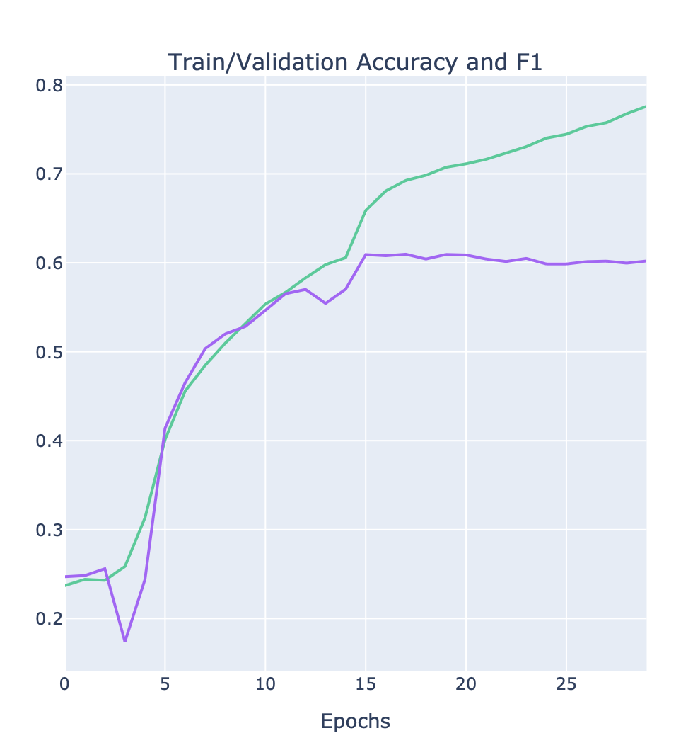
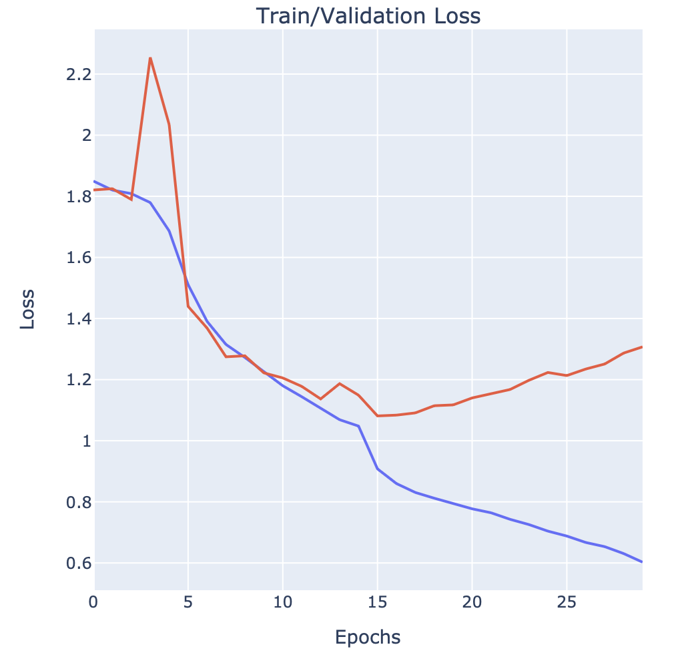
Experiment 5: Train EfficientNet: b0

Slide 21
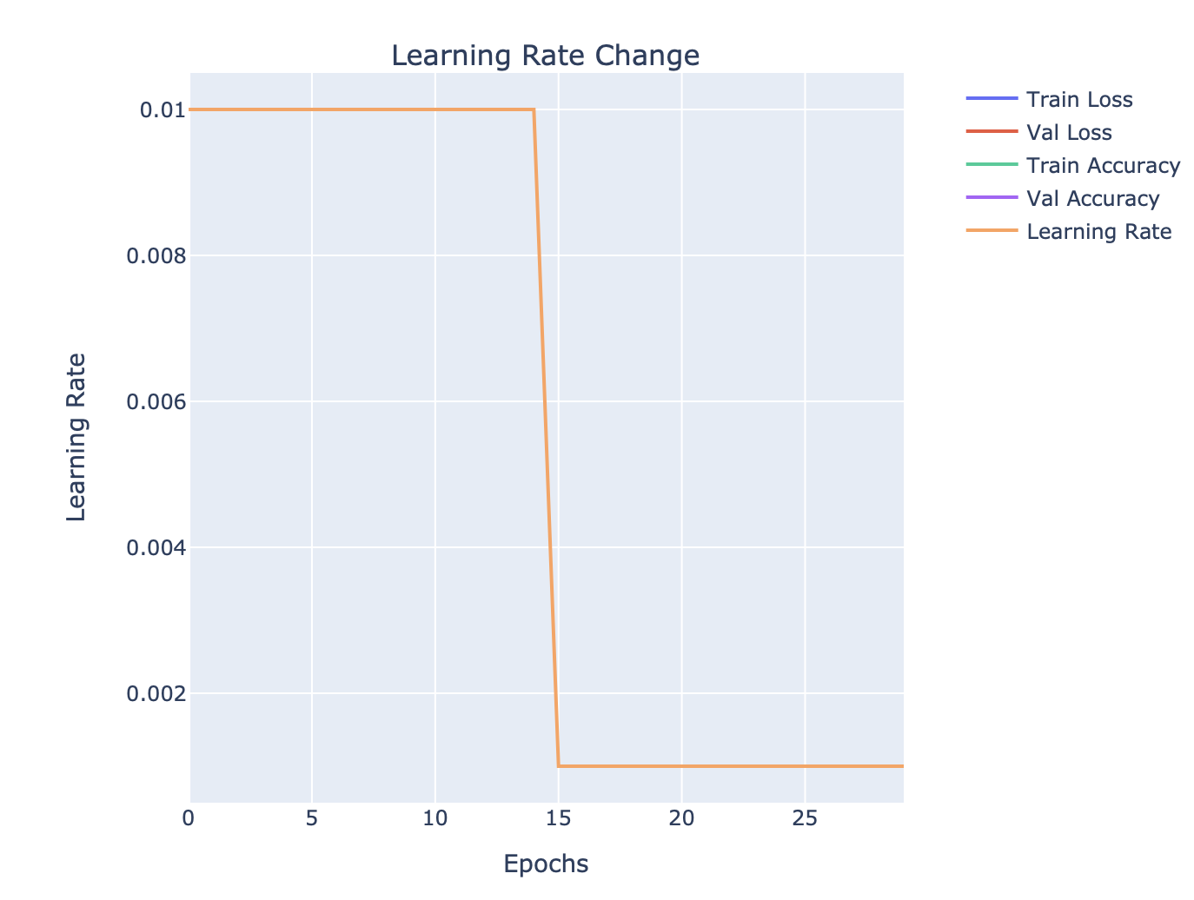
Experiment 5: Train EfficientNet: b0
scheduler = torch.optim.lr_scheduler.StepLR(optimizer, step_size=15, gamma=0.1)
We have used StepLR scheduler to adjust the learning rate of an optimizer every 15 epochs, reducing it by a factor of 0.1. After every step_size epochs, the learning rate will be multiplied by gamma i.e the learning rate will be reduced to 10% (0.1 times) every 15 epochs. This type of learning rate scheduling is often used to gradually decrease the learning rate during training

Slide 22
Experiment 6: Train EfficientNet: b3
We trained the model with LR = 0.01, BATCH_SIZE = 32 and CrossEntropyLoss.
In the training process of our model, we employed the Early Stopping technique to prevent overfitting and enhance model generalization. Activation function: Sigmoid
After training for 30 epochs, the average training metrics were as follows, Loss: 0.48 , Accuracy: 0.821
However, during the validation phase of the 30th epoch, the model exhibited signs of potential overfitting: Validation Loss: 1.46 , Validation Accuracy: 0. 598 .

Slide 23
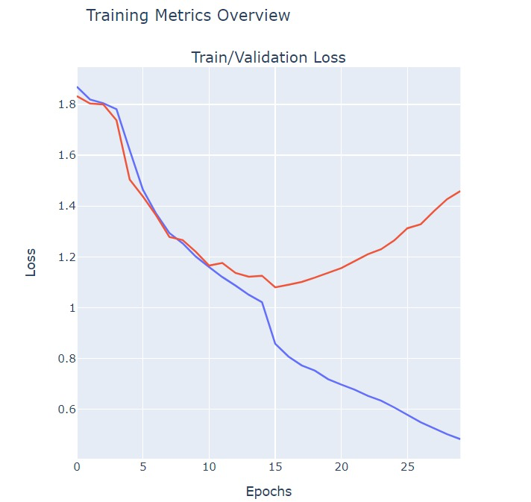
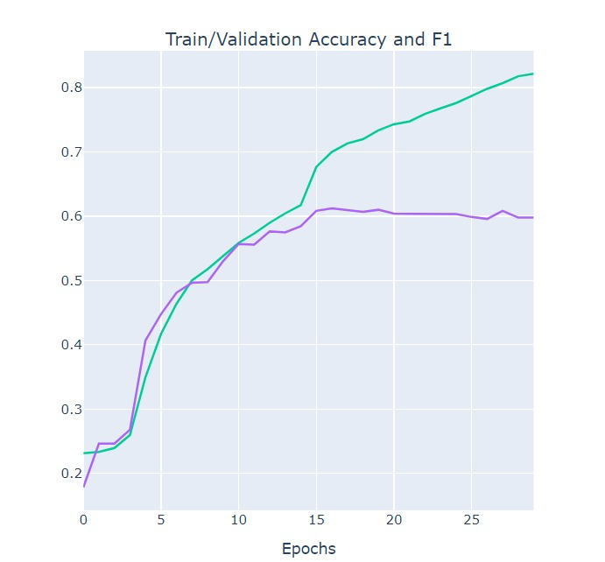
Experiment 6: Train EfficientNet: b3

Slide 24
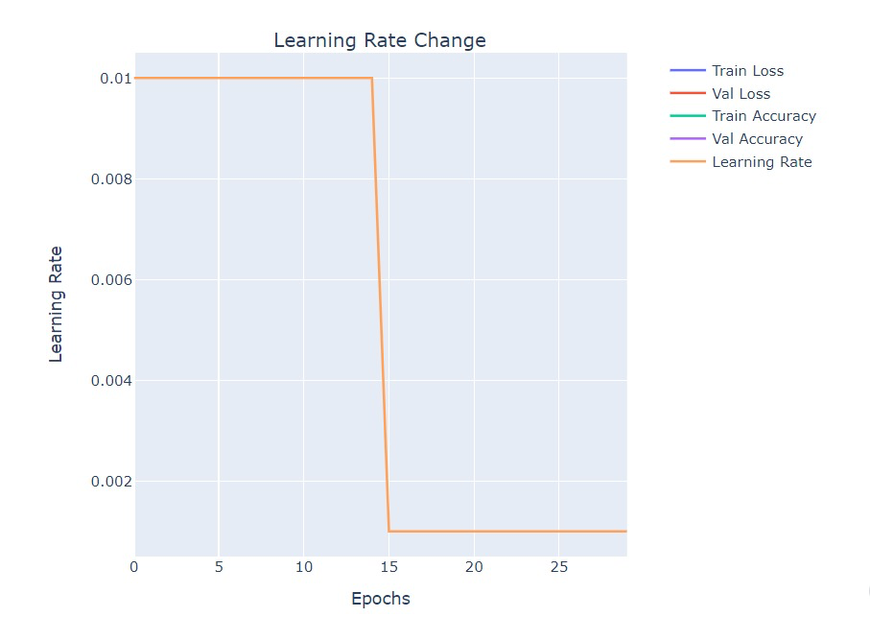
Experiment 6: Train EfficientNet: b3

Slide 25
Experiment 7: EfficientNet b5
We trained the model with LR = 0.01, BATCH_SIZE = 128 and CrossEntropyLoss.
In the training process of our model, we employed the Early Stopping technique to prevent overfitting and enhance model generalization. Activation function: SiLU() and Sigmoid
After training for 30 epochs, the average training metrics were as follows, Loss: 0.4391, Accuracy: 0.82
However, during the validation phase of the 30th epoch, the model exhibited signs of potential overfitting: Validation Loss: 1.4870, Validation Accuracy: 0.603

Slide 26
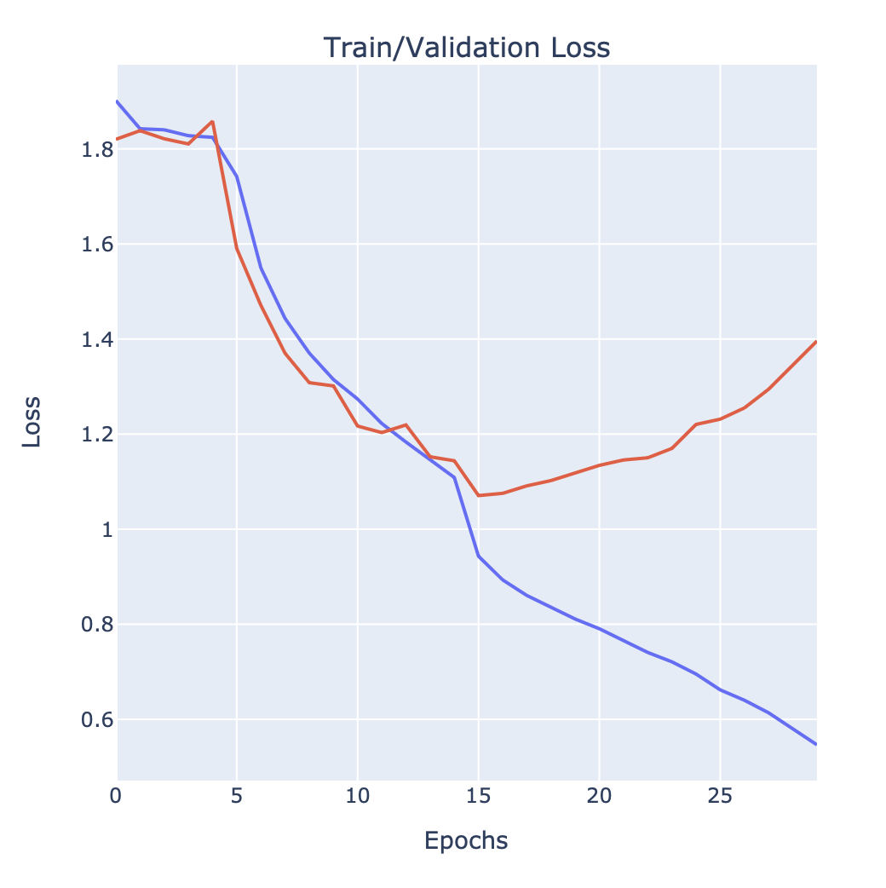
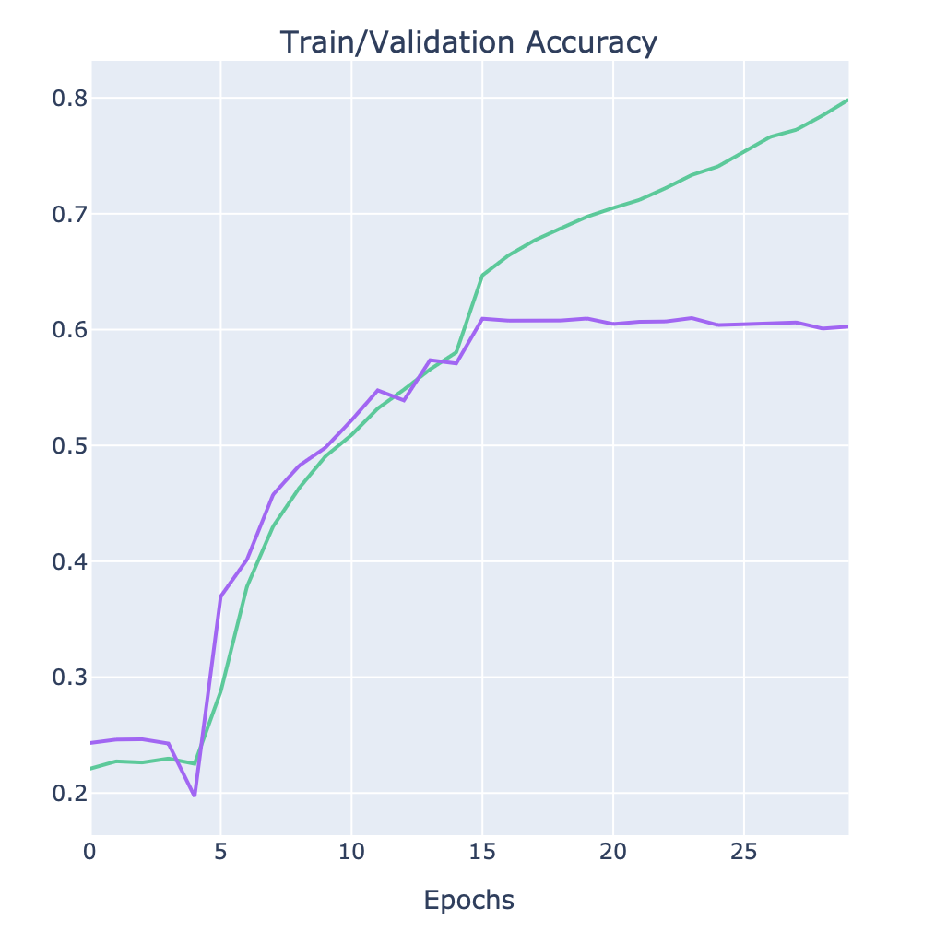
Experiment 7: EfficientNet b5

Slide 27
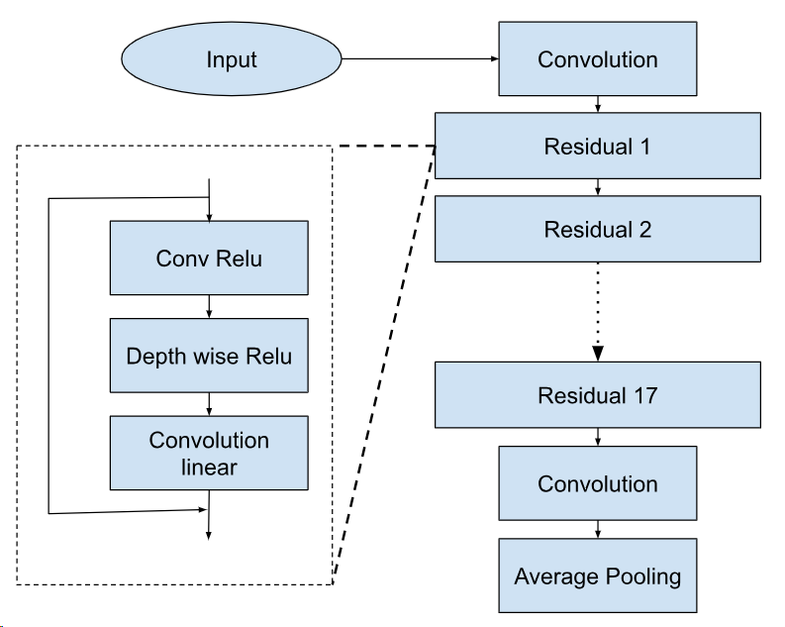
MobilenetV2
Lightweight and efficient
Depthwise Separable Convolutions
Depthwise Convolutions
Pointwise Convolutions
Block Design
Residuals
Linear Bottlenecks
Width Multiplier & Resolution

Slide 28
Experiment 8: MobileNet v2
LR = 0.01, BATCH_SIZE = 32, CrossEntropyLoss, and SGD optimizer
After 15 epochs: Train_Loss = 1.52, Train_Accuracy = 0.40
After 30 epochs: Train_Loss = 1.38, Train_Accuracy = 0.46
Even at the end of 70 epochs: Train_Loss = 1.37, Train_Accuracy = 0.47
Validation_Loss = 1.37, Validation_Accuracy = 0.48
Could be improved

Slide 29
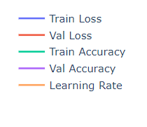
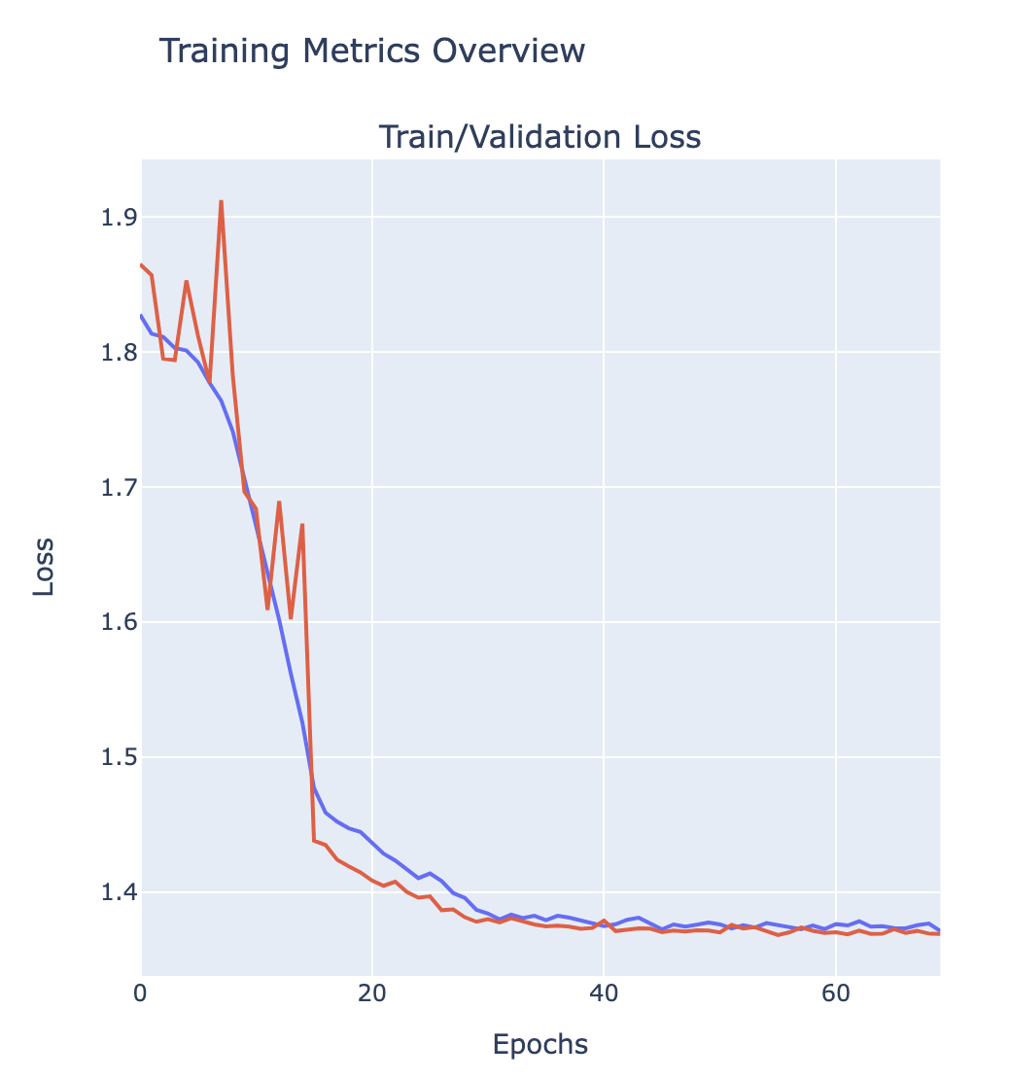
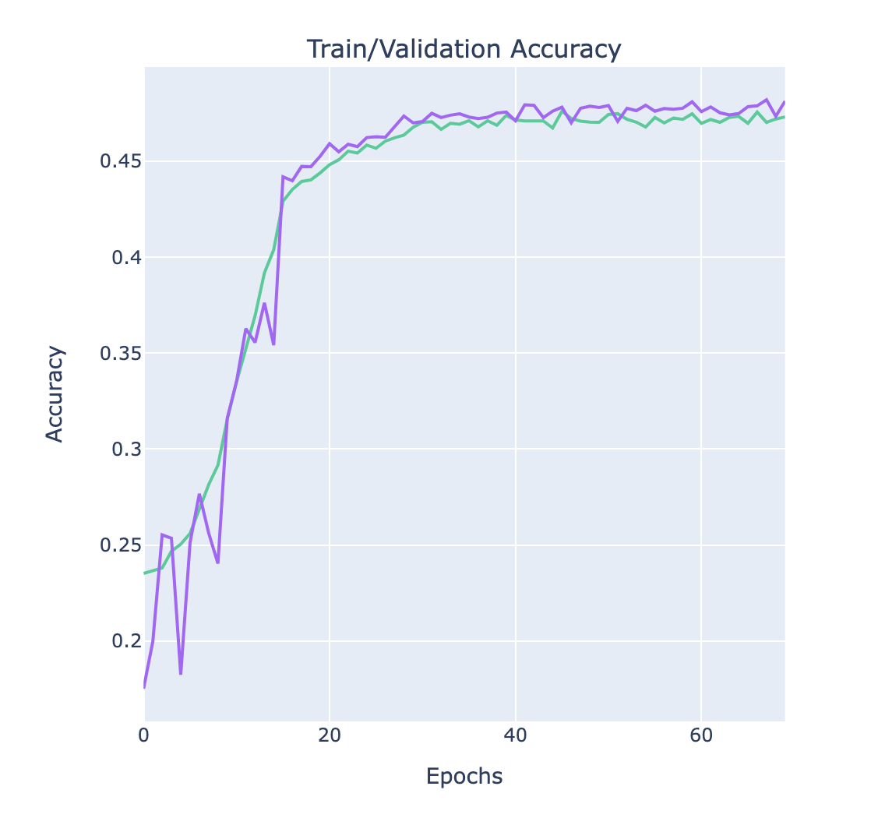
Experiment 8: MobileNet v2 Results

Slide 30
Experiment 9: MobileNet v2
LR = 0.01, BATCH_SIZE = 32, CrossEntropyLoss, SGD optimizer, without transformations
Even at the end of 30 epochs: Train_Loss =0.2624, Train_Accuracy = 0.918
Validation_Loss = 1.8763, Validation_Accuracy = 0.516

Slide 31
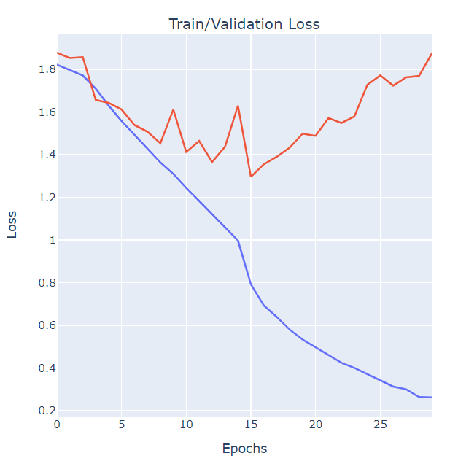
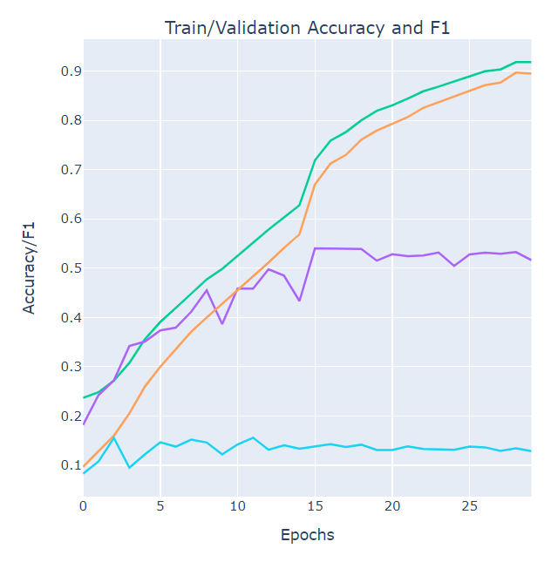
Experiment 9: MobileNet v2 Results

Slide 32
Experiment 10: MobileNet v2
LR = 0.01, BATCH_SIZE = 32, CrossEntropyLoss, Adam optimizer, without transformations
After 27 epochs:
Final Train_Loss = 0.11, Train_Accuracy = 0.96
Validation_Loss = 1.35, Validation_Accuracy = 0.61
Still overfits

Slide 33
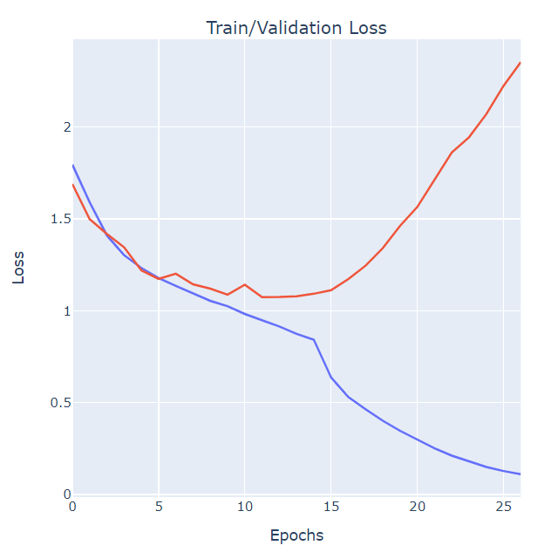
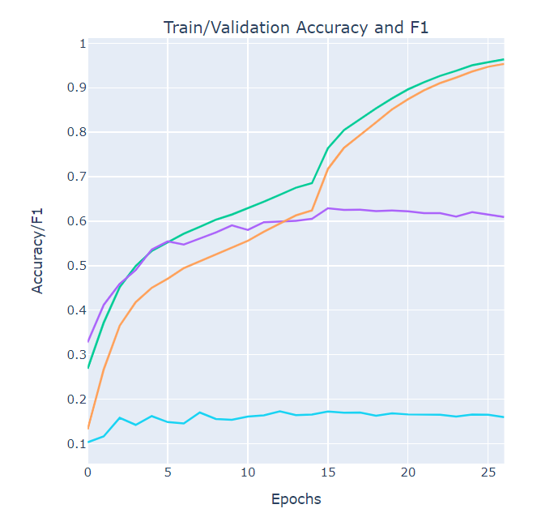
Experiment 10: MobileNet v2 Results

Slide 34
Experiment 11: MobileNet v2
LR = 0.01, BATCH_SIZE = 32, CrossEntropyLoss, and Adam optimizer
After 15 epochs: Train_Loss = 1.21, Train_Accuracy = 0.54, LR=0.01
After 30 epochs: Train_Loss = 1.00, Train_Accuracy = 0.62, LR=0.001
Ends after 62 epochs due to early stopping
Final Train_Loss = 0.97, Train_Accuracy = 0.63, LR=0.000001
Validation_Loss = 1.05, Validation_Accuracy = 0.60
Significantly Better Performance

Slide 35
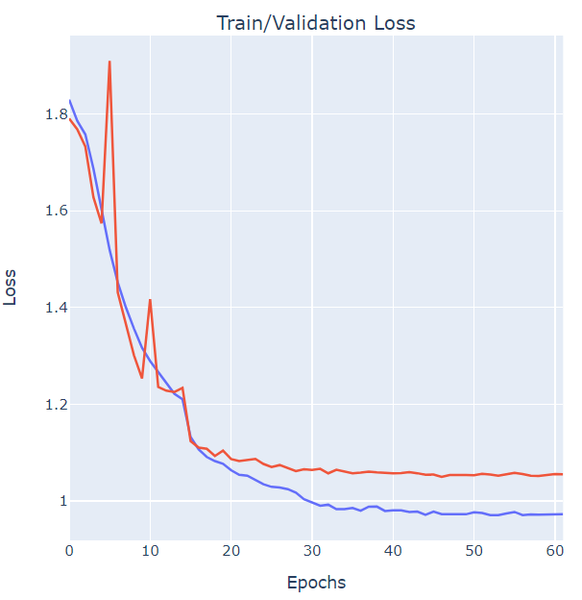
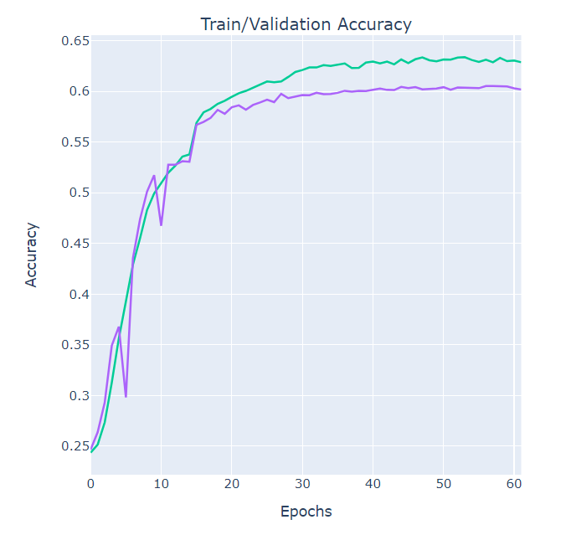
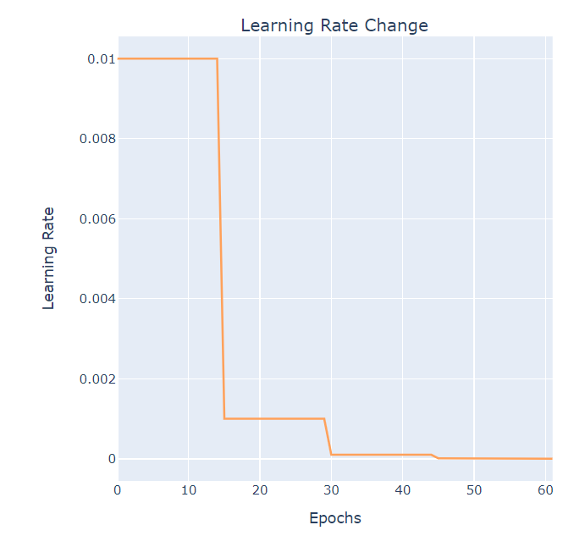
Experiment 11: MobileNet v2 Results

Slide 36
Demo
We use the Cv2 library to detect the face emotions through Web camera cv2.CascadeClassifier(cv2.data.haarcascades + 'haarcascade_frontalface_default.xml')
It captures video frames, detects faces using the Haar Cascade classifier, and then predicts emotions for each detected face using a deep learning model. The detected faces are outlined with rectangles, and the predicted emotions are displayed on the video feed.

Slide 37
THANK YOU

